Slide 1
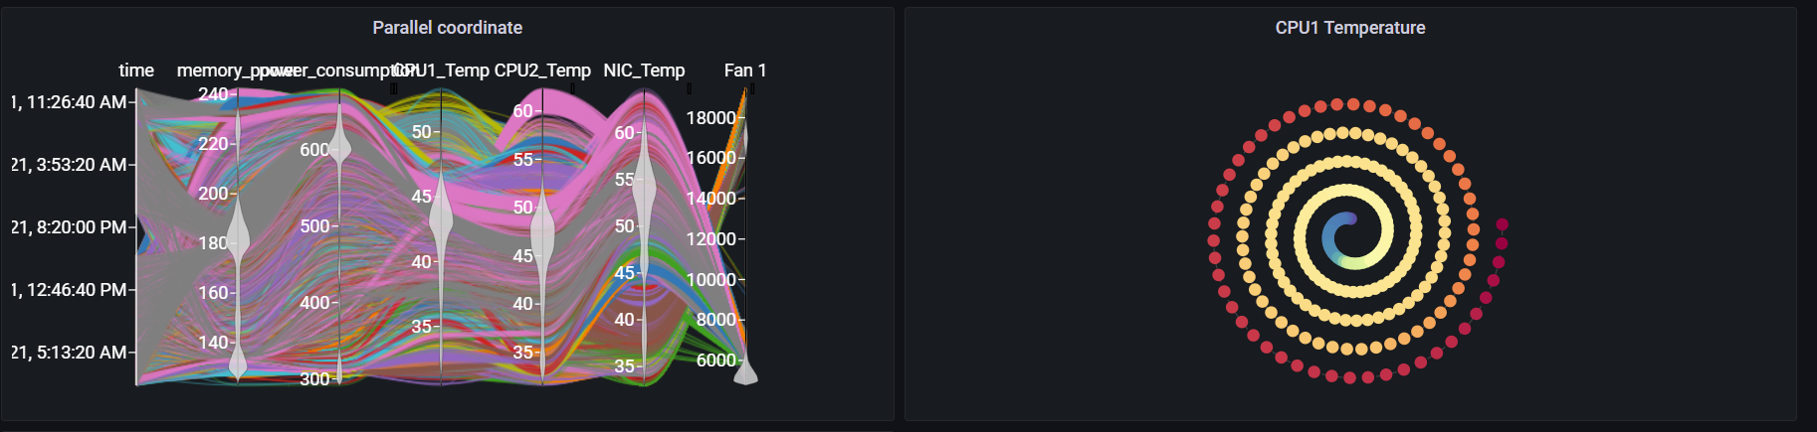
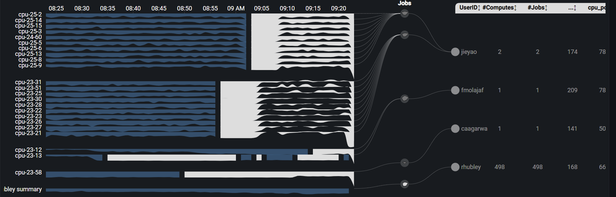
Grafana Plugin
Weekly report

Slide 2
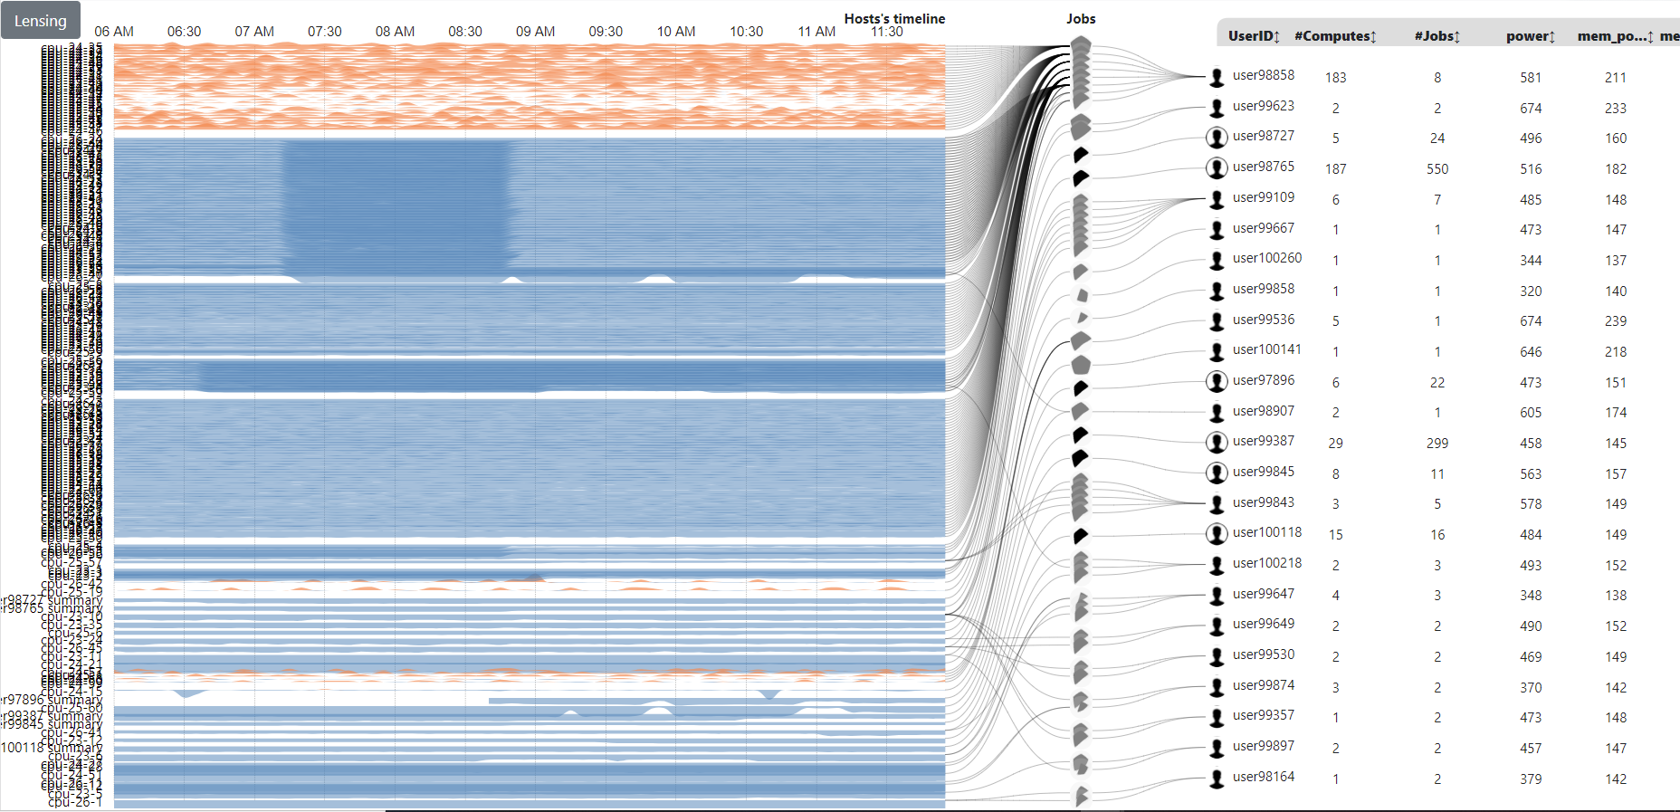
Original visualization
https://idatavisualizationlab.github.io/HPCC/PowerMap/

Slide 3
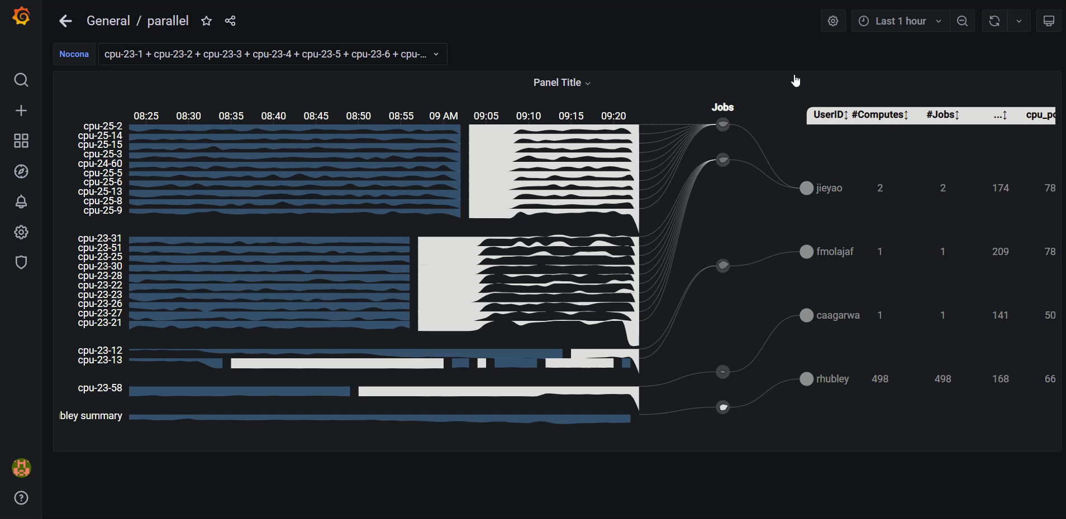
Previous result
Primary app: https://idatavisualizationlab.github.io/HPCC/PowerMap/

Slide 4
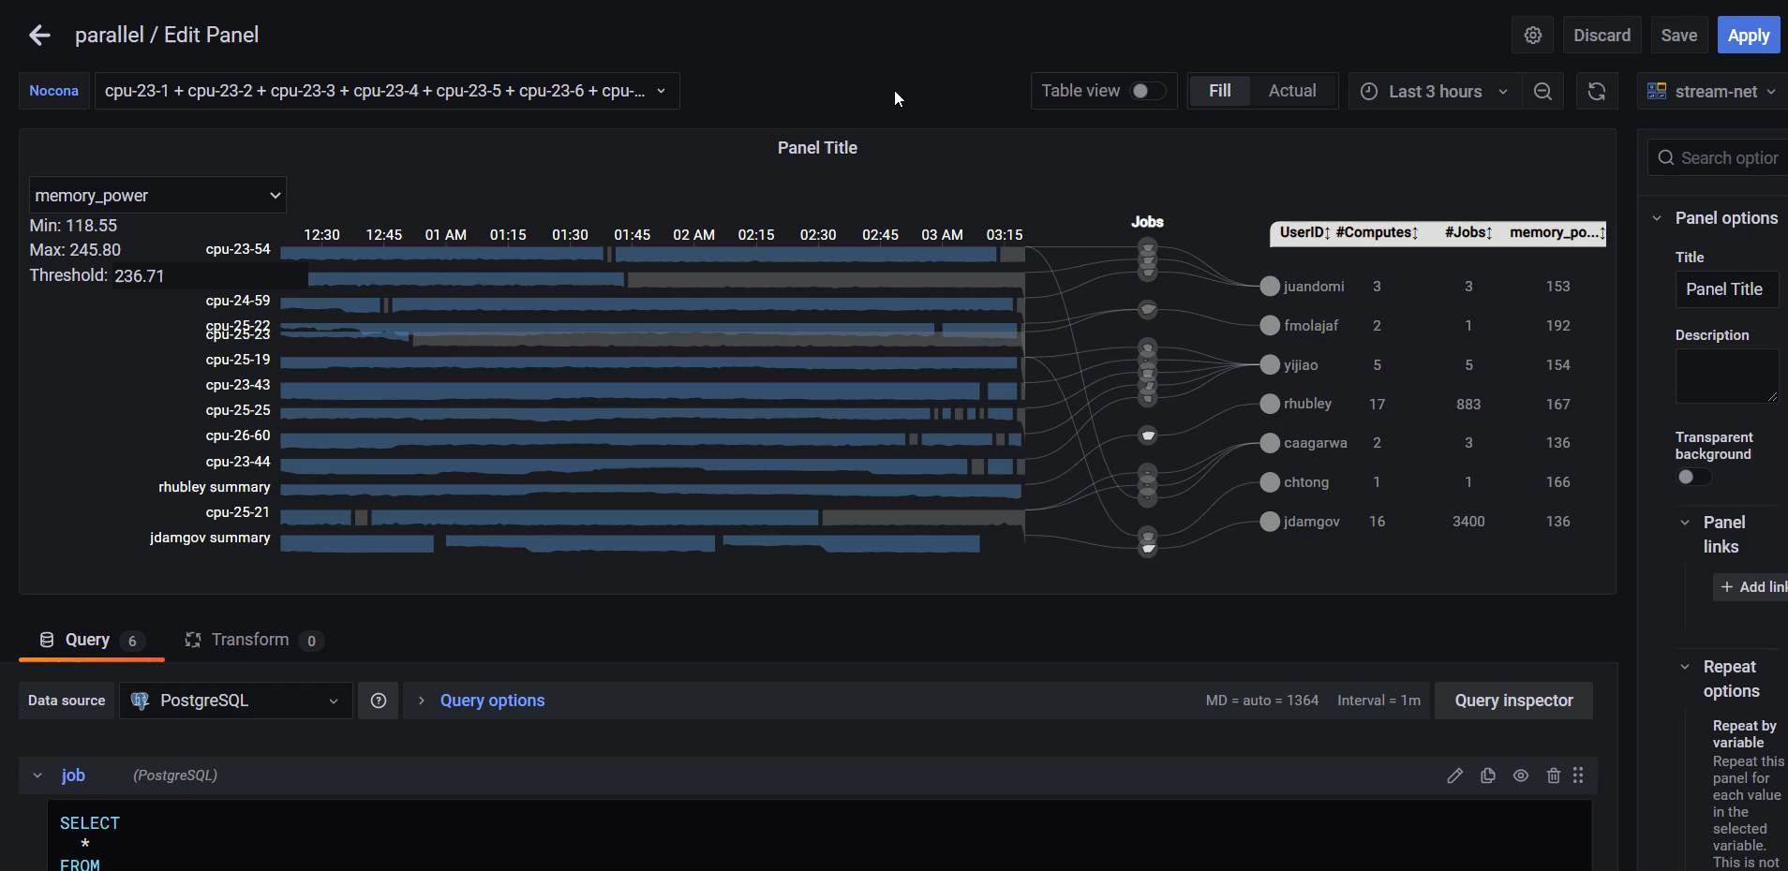
Previous result
Primary app: https://idatavisualizationlab.github.io/HPCC/PowerMap/

Slide 5
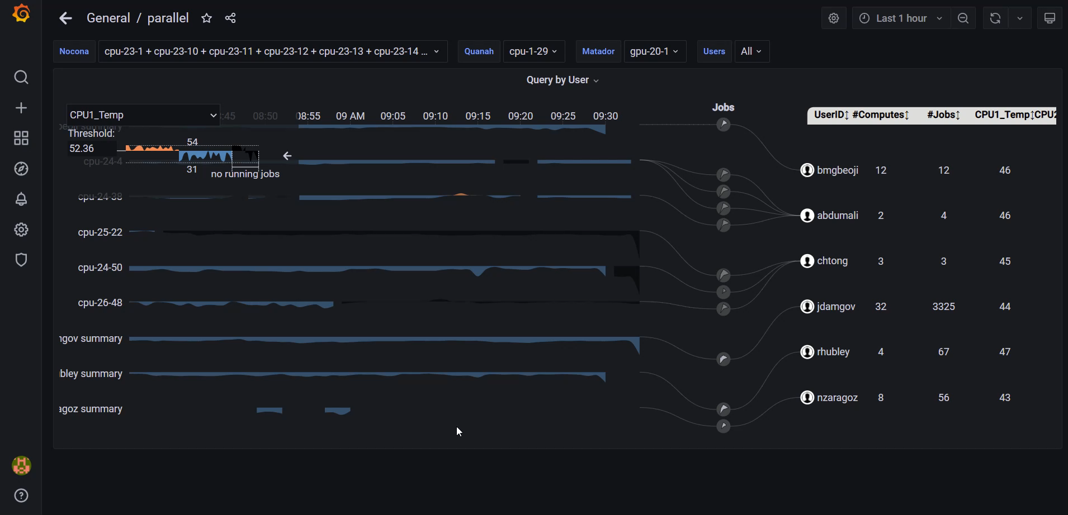
Current result
Primary app: https://idatavisualizationlab.github.io/HPCC/PowerMap/

Slide 6
Current features
Power streamDisplay user/job/compute
Control stream threshold
Legend

Slide 7
Future features
Lensing
Filter function

Slide 8
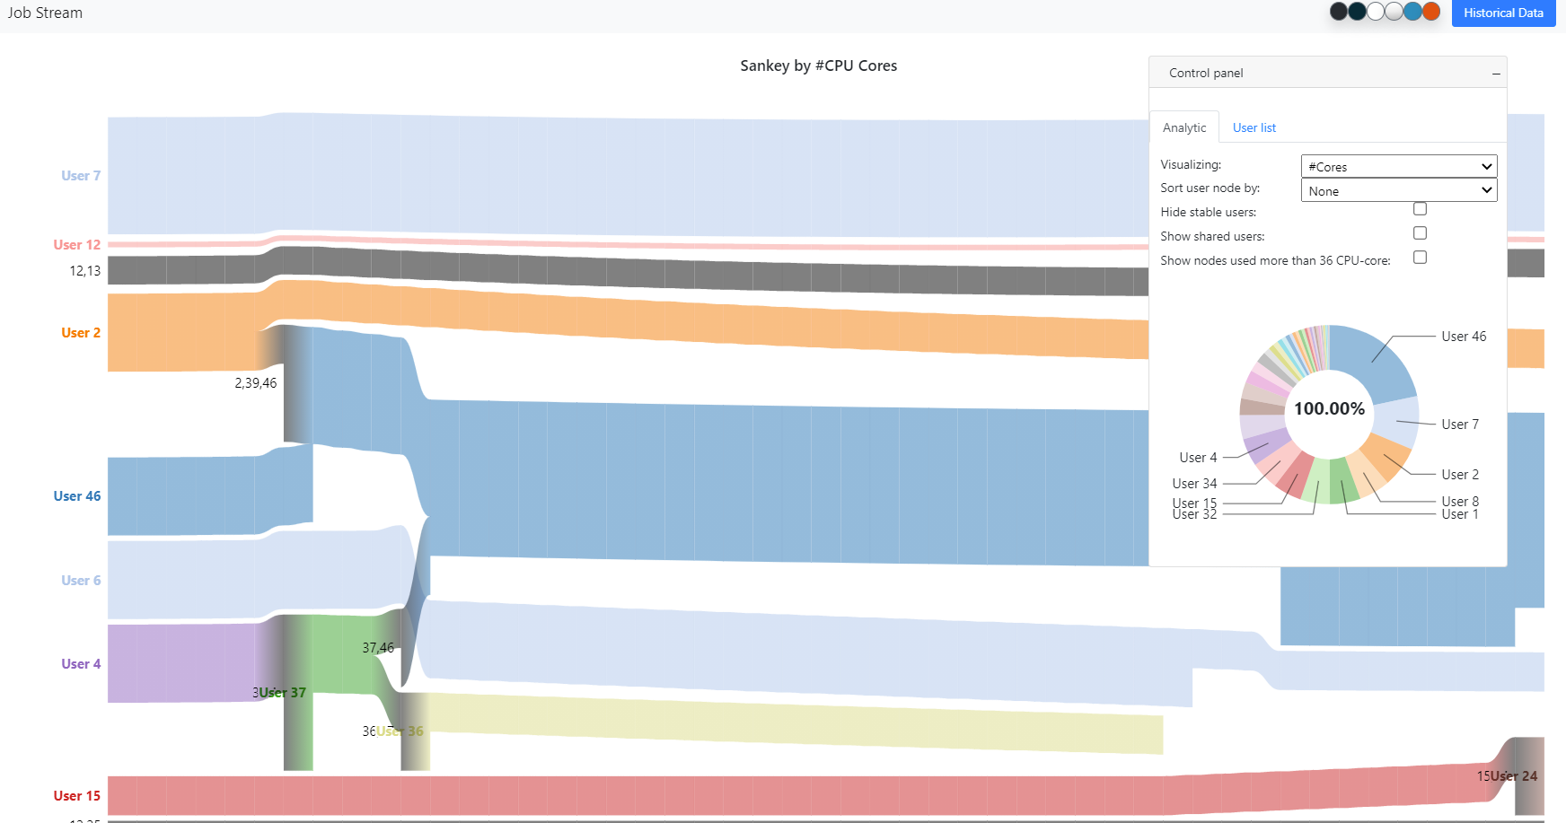
Sankey

Slide 9
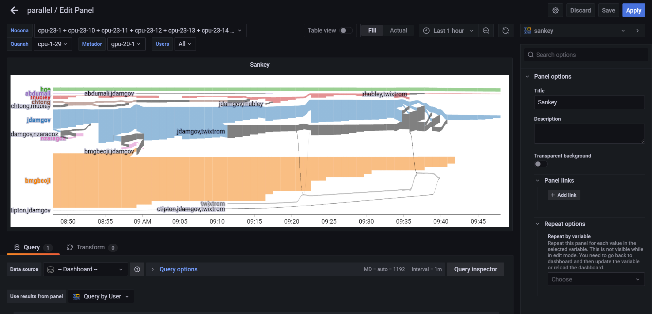
Current result | Sankey by core

Slide 10
Current features
Sankey by core
Zoom/Pan

Slide 11
Future features
Summary pie chart
Interaction/ tooltip
Gradient in stream

